Slide 1
Stress Testing Banks’ Exposure to Geopolitical Risk
Hamza Ghoussy (2763379), Corentin Lepla (2898108),
Shubham Vijay Nanewar (2891203), Andreas Koulopoulos (2897428)

Slide 2
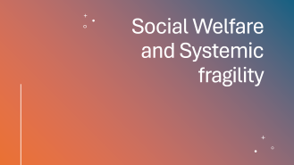

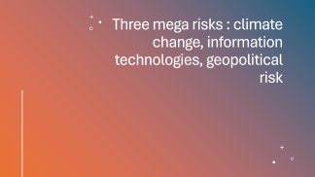
Motivation

Slide 3
Social Welfare and Systemic fragility

Slide 4
Three mega risks : climate change, information technologies, geopolitical risk

Slide 5
Sovereign bank nexus

Slide 6

Literature Gap
The Evolution of Stress Testing: From SRISK to Geo-RISK
Long short mimicking portfolio as a more representative stress testing tool
Quantile regression vs OLS

Slide 7
Methodology & Data

Slide 8
Hypothesis & Preliminary results
Hypotheses : “Banks with large market capitalization and significant global exposure exhibit a negative sensitivity to geopolitical stress. During periods where geopolitical risk drives capital into defensive sectors (Energy and Defence), these large institutions will experience equity devaluations exceeding those predicted by the broad market beta “
Negative Geopolitical Sensitivity

Slide 9
Future Work

